Slide 1
Line Methods and Direction Set Methods in Multidimensional Optimization
From 10.6 (linmin) to 10.7 (Powell’s Method)

Slide 2
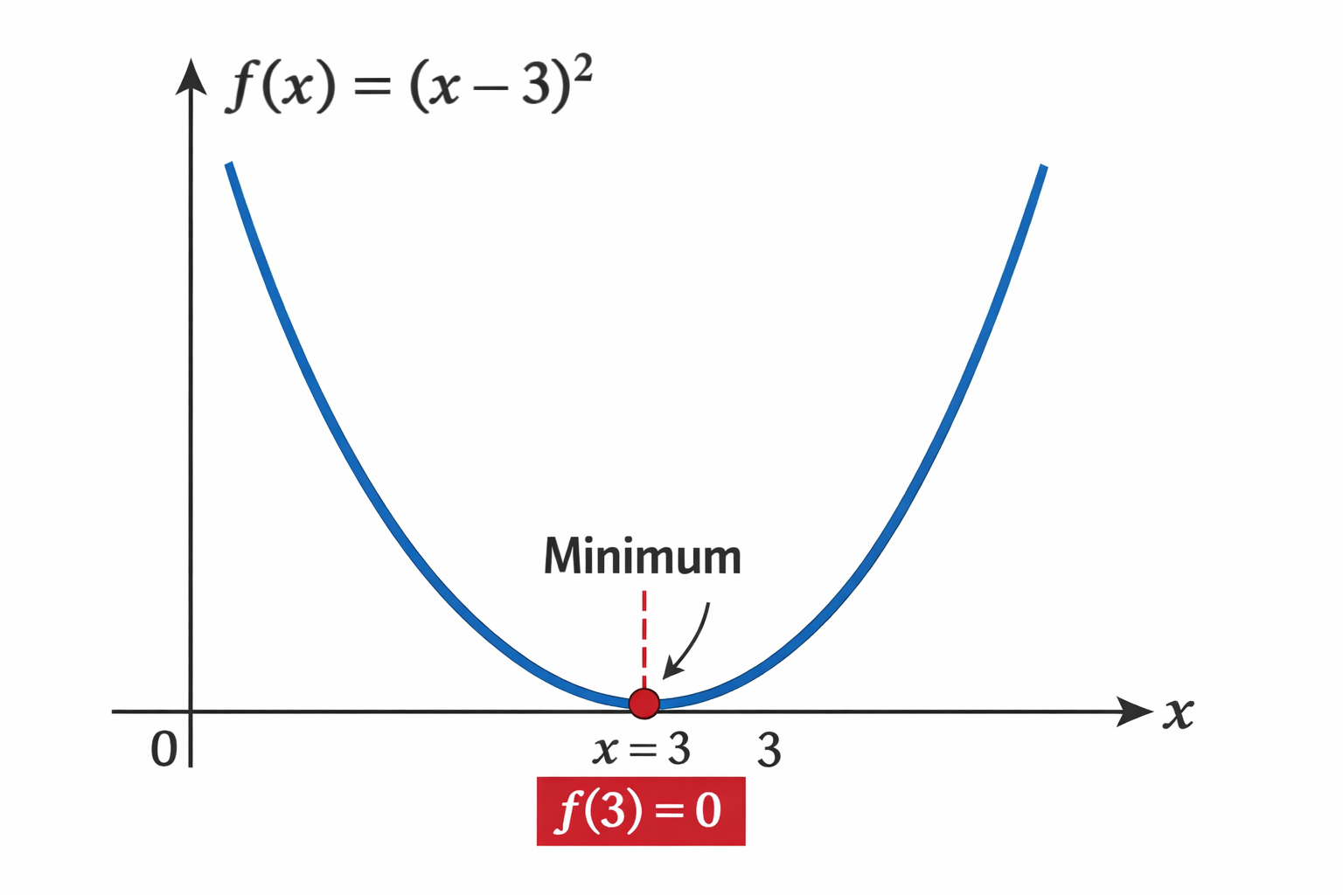
What Does It Mean to Minimize a Function?
Goal:
A function that maps inputs to outputs
We want the input that produces the smallest output
Example: f(x) = (x - 3)^2, minimum occurs at x = 3, f(3) = 0

Slide 3
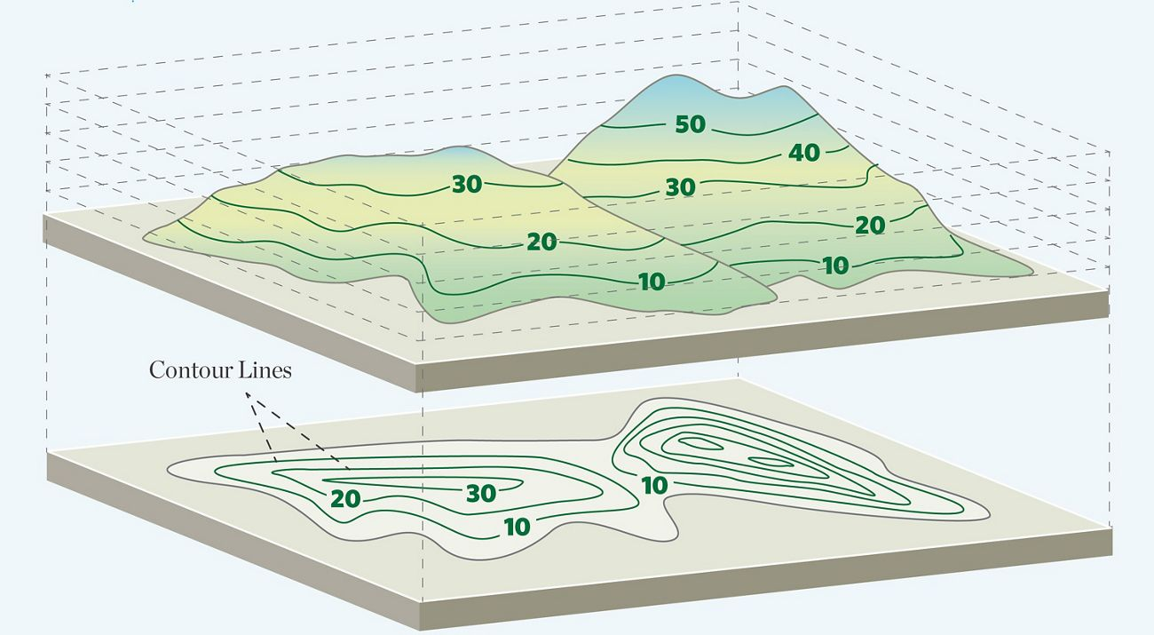
From One Variable to Many Variables
One variable: f(x)
Many variable: f(x,y), f(x,y,z), f(x)
Represents a surface or landscape
Hard to search directly
Analogy: Finding the lowest point on a mountain

Slide 4
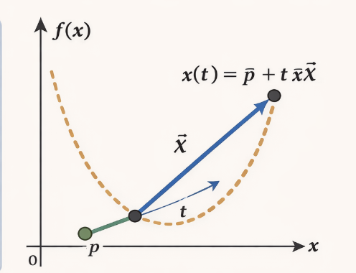
Key Idea of 10.6: Reduce to One Dimension
Instead of searching everywhere:
Pick a starting point
Pick a direction
Move along that straight line
Mathematically:
x(t)=p+tξ
Define :
g(t)=f(p+tξ)
Thus the problem is now a one dimensional problem

Slide 5
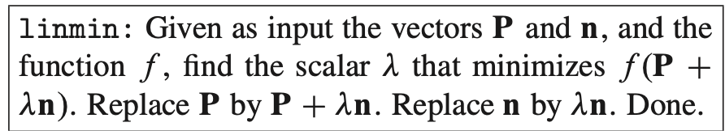
What linmin Does (10.6)
Input:
Current point, p
Direction, ξ
function , f
Output:
Moves p to the min along that line
Returns the function value

Slide 6
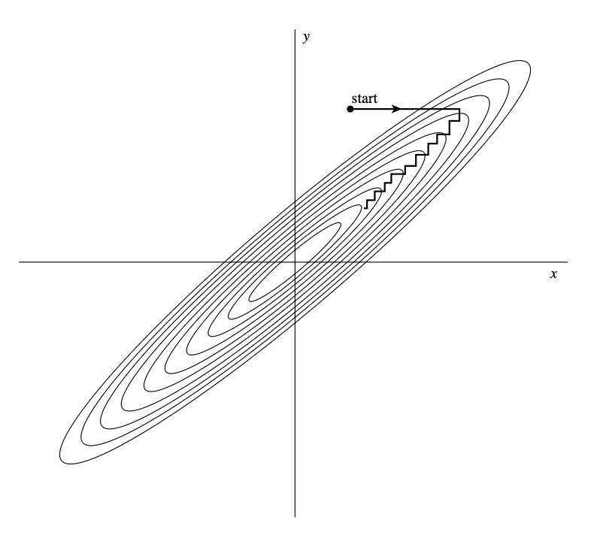
Big Question: Which direction should we choose next
From 10.6 we already know how to move to the best point along one chosen direction using linmin()
If we choose directions poorly, the algorithm can be extremely slow.

Slide 7
Goal of Direction Set Methods (10.7)
Instead of fixed directions:
Update directions as the algorithm runs.
Learn directions that follow valleys.
Avoid undoing previous progress.
Goal:
Move efficiently toward the minimum.

Slide 8
Conjugate Directions
Two directions are conjugate if:
Moving along one does not ruin the minimization along the other.
If we find N conjugate directions:
A quadratic function can be minimized in N line searches.
Key idea:
Directions should not interfere with each other.

Slide 9
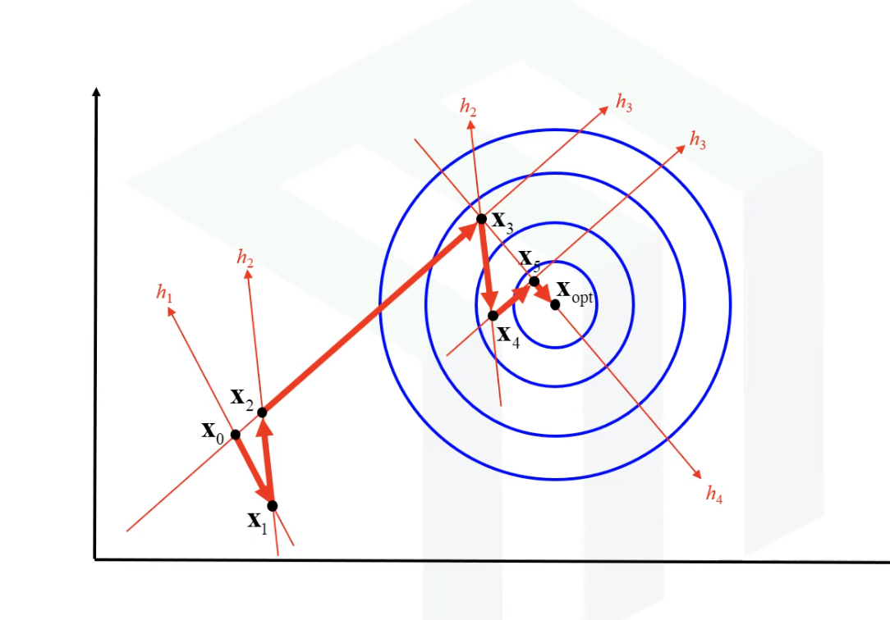
Powell’s Method
Start with coordinate directions.
Run linmin along each direction.
Measure the net movement direction.
Add this new direction.
Remove one old direction.
Repeat until improvement is small.
Notes:
https://www.youtube.com/watch?v=1Z_4sBNoZj4

Slide 10
Overall Summary
Why powell works better:
Learns good directions automatically
Avoids zig-zagging
Faster convergence than coordinate descent
Works without gradients
10.6: How to move optimally along one direction (linmin).
10.7: How to choose and update directions intelligently (Powell).
Together they solve multidimensional minimization efficiently.

